Slide 1
WHERE THERE IS SMOKE, THERE IS…
Dr. Sajni Pabari
MBCHB, MMED (Int. Medicine),
WGO Gastroenterology Fellow.

Slide 2
Objectives:
Definition
Lesions and epidemiology
Why do we need to diagnose them early
Who to screen
Diagnosis
Management
Take home

Slide 3
Premalignant and malignant lesions of the upper G. I tract:
The upper G.I tract primarily involves the esophagus, stomach and the first part of the duodenum
A pre-malignant lesion are changes or conditions in the upper GI tract that can potentially lead to the development of cancer if not detected and treated early
A malignant lesion cancerous growth in the upper G.I tract

Slide 4
Lesions and epidemiology:
Barret's esophagus:
Healthy esophageal epithelium is replaced with metaplastic columnar cells due to damage from prolonged exposure of the esophagus to the refluxate of GERD
55 – 65years, M>F – 3:1, whites >> others
1% worldwide prevalence
10 – 55X risk of developing esophageal adenocarcinoma
Epidemiology of Barrett’s Esophagus and Esophageal Adenocarcinoma, Gastroenterol Clin North Am. 2015 Apr Thomas M Runge

Slide 5
2. Atrophic gastritis:
loss of gastric glands, with or without metaplasia, in the setting of chronic inflammation mainly due to Helicobacter pylori infection or autoimmunity
Prevalence is 6 - 40% in Africa
50 – 60years, H. Pylori >> Autoimmune gastritis, H. Pylori – M:F – 1:1, autoimmune F>M – 3:1
0.1 – 0.3% annual risk of gastric carcinoma or NET
Helicobacter pylori gastritis in Africa , Eur J Gastroenterology hepatology, 2000, June, E J Kuipers
Notes:
H,pylori - 1-2%/year of atrophic gastritis

Slide 6
3. Intestinal metaplasia:
the lining of the stomach or esophagus transforms into tissue resembling that of the intestine
H. Pylori > chronic gastritis > smoking > alcohol
< 0.25% transformation to cancer/year
Altayar O, Davitkov P, Shah SC, et al. AGA Technical Review on Gastric Intestinal Metaplasia-Epidemiology and Risk Factors. Gastroenterology 2020; 158:732.

Slide 7
.
4. Gastric dysplasia:
presence of histologically unequivocal neoplastic epithelium without evidence of tissue invasion
precancerous lesion and the penultimate stage in gastric carcinogenesis, particularly the intestinal type
Occurring in 0.5 – 20%, depending on location
LGD – 3 - 9%, HGD – 25%
Diagnosis and management of gastric dysplasia, 2016 Feb 26, Jae Kyu Sung

Slide 8
5. Gastric polyps:
projections of mucosal or submucosal tissue into the stomach lumen, representing many tissue types with a spectrum of malignant potential
fundic gland < hyperplastic < adenomatous polyps.
2% prevalence
Malignant in 1-2% cases
Gastric Polyp, Christopher D. Arteaga; Roopma Wadhwa, October 9, 2024.

Slide 9
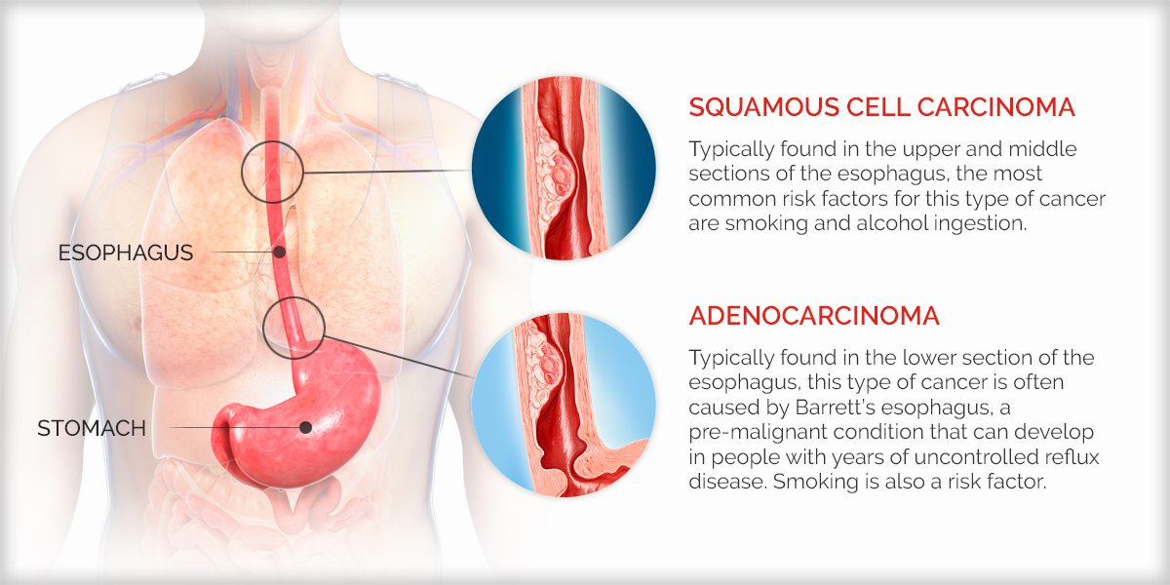
Malignant lesions:
1. Esophageal cancers:

Slide 10
4th most common cancer in Kenya, 17.6 per 100,000
2nd commonest cancer in males
M>F
Squamous cell > adenocarcinoma
Mean age 50 – 58 years
Esophageal cancer in Kenya, 2017 Jun 30;4(3):23–33, Joab Otieno Odera
Notes:
Mean age in western world 65- 74, western kenya - <30years

Slide 11
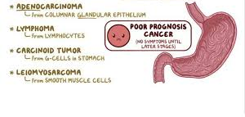
2. Gastric cancer:

Slide 12
Gastric cancer is the 9th commonest cancer in the country
Adenocarcinoma is the commonest
F >M , approx. 7.5 per 100, 000, with a high mortality of 6.6 per 100,000
Mean age – 58- 61years
Gastric cancer at the Kenyatta National Hospital Blood Group Distribution, helicobacter pylori status and dietary patterns in patients with gastric carcinoma, 2004, Jane K

Slide 13
Why diagnose them early:
1. Financial Burden - ?SHA, average income of a kenyan
2. Emotional Burden
3. Physical Burden
4. Systemic Burden
Notes:
1, treatment cost (National insurance/self), lost income, increases related costs (transport), care giver burden
2. Stress, anxiety,depressiom, emotional support needs – both personal and for care giver
3. Side effects, long term associated illness, impact on daily life
4. Healthcare infrastructure, shortage of trained professionals, access to care

Slide 14
Who to screen:
Lack of global guidelines
Kenyan guidelines for esophageal cancer:
Individuals with first degree relatives with biopsy proven esophageal cancer should have screening endoscopy 10 years prior to index age of diagnosis of the first degree relative or at age 40 whichever is earlier
Asymptomatic individuals living in high-risk areas should get a one-time screening endoscopy at age 40 years.
Patients treated for head and neck cancer squamous cell carcinoma should be screened annually for ten years.
Patients who have had caustic acid ingestion should be screened 10years from the injury via endoscopy
Notes:
High risk - Western region, including the Central Nyanza district and the Rift Valley, especially among the Kalenjin community
Risk Factors for BE and EAC:
Age: Older than 50 years
Sex: Male
Ethnicity: Caucasian
Tobacco Use: Smoking
Obesity: High BMI
Family History: First-degree relative with BE or EAC
Chronic GERD: Symptoms of GERD for 12 months or longer

Slide 15
Gastric cancer guidelines:
No global/local guidelines
Do the numbers justify population-based screening?
Proposed screening recommendations:
High risk population – first generation immigrants from high/moderate incidence regions, family history, hereditary polyposis syndromes
Patients with alarm signs
History of pre- malignant lesions
Notes:
Smoking, Diets high in salt, smoked foods, salted fish and meat, and pickled vegetables, Helicobacter pylori infection, Previous gastric surgery, ernicious anemia, Adenomatous polyps, Chronic atrophic gastritis, Radiation exposure

Slide 16
How to screen:
Upper G.I endoscopy remains the gold standard
Others :
Imaging – CT, barium swallow, EUS and PET scanning
Breath test- still in research phase
Cytosponge screening test
Blood markers- to check for autoantibodies and methylated DNA marker

Slide 17
Upper G.I endscopy:
1.White Light Endoscopy
2. Chromo-endoscopy
3. Narrow band Imaging endoscopy
4. Magnification endoscopy

Slide 18
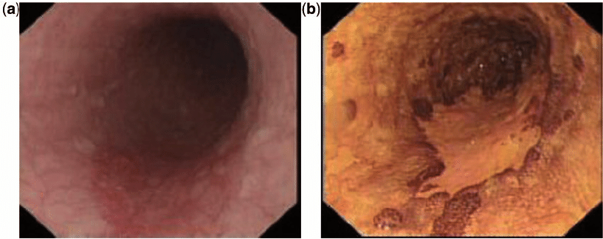
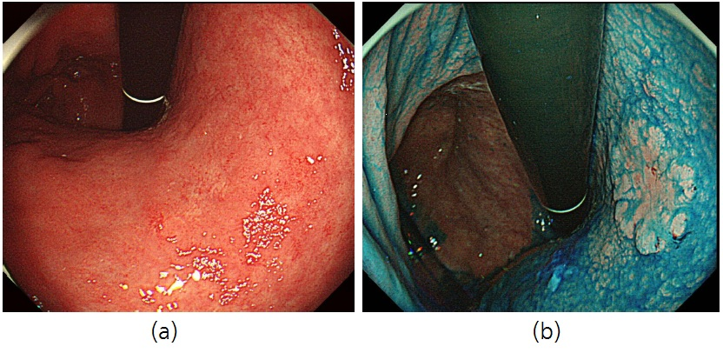
White light endoscopy:

Slide 19
Chromo endoscopy:
Notes:
A study by NIH showed a 44% increase in diagnostic yield, some studies go as high as 80%
Lugol's solution for esophagus. It stains normal squamous tissue dark brown due to the presence of glycogen, while areas of dysplasia and cancer will show reduced or absent staining.
Methylene blue for stomach
Others – acetic acid , indigo carmine
1% Lugol's solution (which contains iodine and potassium iodide) 1:3 or 1:5 with distilled water, resulting in a 0.3% solution ready for use, or diluting 1:10 for iodine titration solutions
dissolving 1.0 g of methylene blue chloride in 10 mL of 95% ethyl alcohol, then adding 100 mL of distilled water and 5 mL of phenol, according to For a working solution, this stock solution is then diluted 1:10 with distilled wate

Slide 20
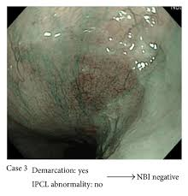
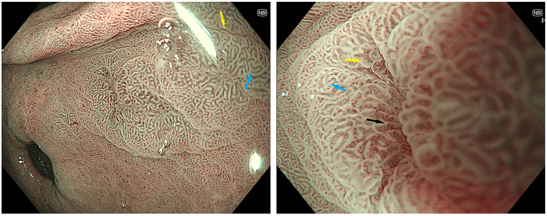
Narrow band imaging:
Notes:
Enhanced visualization, Improved detection rates, improved delineation
79% vs 57%

Slide 21
NBI with magnification:
Notes:
magnifying NBI (M-NBI) achieved higher accuracy (90.4%) and specificity (94.3%) compared to WLE (64.8% and 67.9%, respectively).

Slide 22
Other tricks and turns:
Appropriate patient preparation
Procedure checklists
Adequate sedation
Correct equipment + accessories
Trained endoscopists
Enough photos
Sufficient withdrawal time
Correct and detailed reporting with standardized terminology
Regular audits
Notes:
Explain the procedure, fasting 6-8 hours
Calm patient = adequate examination, avoidance of retching
Equipment – do an equipment check, make sure you have all the accessories for anticipated procedure
What the brain doesn’t know the eyes cannot see
Photos – 20 – 40 photos
7- 8min ogd
A g.i malignancy detected withing 3 years of a previous OGD is considered a missed diagnosis

Slide 23
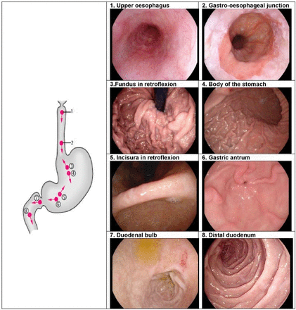
Notes:
(ESGE) guidelines describe a systematic approach to photo-documentation , with a recommendation of eight anatomical landmarks
Ensures adequate exam, allows one to come back and review, aids record keeping for patient, research and legal reasons

Slide 24
Management:
Lifestyle modifications
Medical
Endoscopic
Surgical
Psychological support

Slide 25
Take home:
A good history and exam will guide you to screening
When performing a screening OGD, utilize all available aids to do a proper examination
Prevention is better than cure
Early diagnosis and treatment
Regular surveillance
Practice based/ hospital based audits
Guidelines

Slide 26
THANK YOU

